Slide 1

Python Project Random Password Generator
Presented By: Shayali Navghare
Notes:
1

Slide 2

Agenda
Introduction
What Is Python?
To Build This Project We Have Use The Basic Concept Of Python
Demo
Conclusions
2

Slide 3





Introduction
A random password generator is software program that takes input from a random generator and automatically generates a password.
With Growing Technology, everything has relied on data and securing these data is the main concern. Password Generator is used in a way through which highly secure passwords are generated that is really hard to crack or hack.
3
Notes:
3

Slide 4

What Is Python?
Python is dynamically-typed and garbage-collected. It supports multiple programming paradigms, including structured (particularly procedural), object-oriented and functional programming.
Additionally, Python's support of modules and packages facilitates modular programs and reuse of code.
Python is an open source community language, so numerous Independent programmers are continually building libraries and functionality for it.
4
Notes:
4

Slide 5
To Build This Project We Have Use The Basic Concept Of Python:
Random Module:
We are making use of random.choice() function to select random characters from it.
MySQL.Connector Module:
MySQL Connector module use for Python programs to access MySQL databases.
Exception handling with try and finally:
Try: This block will test the excepted error to occur
Finally: Finally block always gets executed either exception is generated or not
User-Defined Functions:
def is the keyword for defining a function.
Python String Methods:
Python has a set of built-in methods that you can use on strings. We are using capitalize(), center() and upper()
5

Slide 6
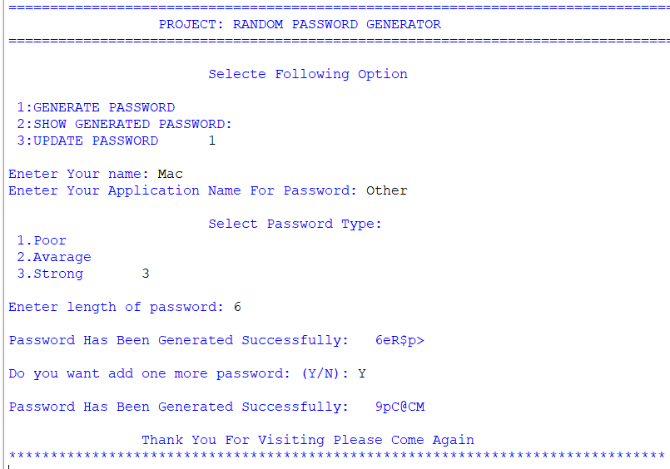
Random Password Generator Demo: 1. Generate Password

Slide 7
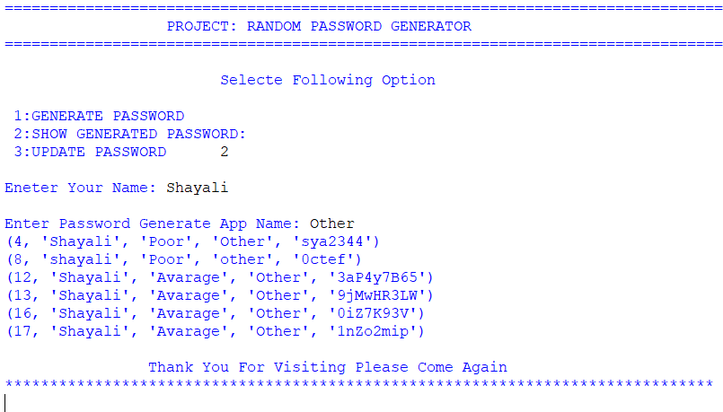
Random Password Generator Demo: 2. Show Generated Password

Slide 8
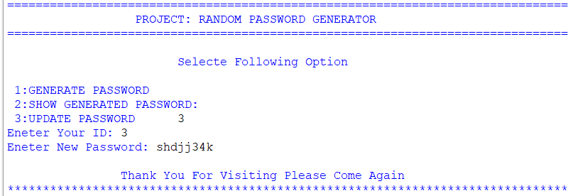
Random Password Generator Demo: 3. Update Password

Slide 9
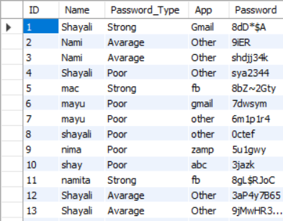
Random Password Generator Demo: Database:

Slide 10
Conclusions
With these steps, we have successfully created a random password generator project using python.
This is a basic GUI Based system, specially made for the learners. Use for education purpose only!

Slide 11
References:
Shabnam Mam Notes from Itvedant.
Punit Sir From Itvedant.

Slide 12


Thank You
12

